Slide 1
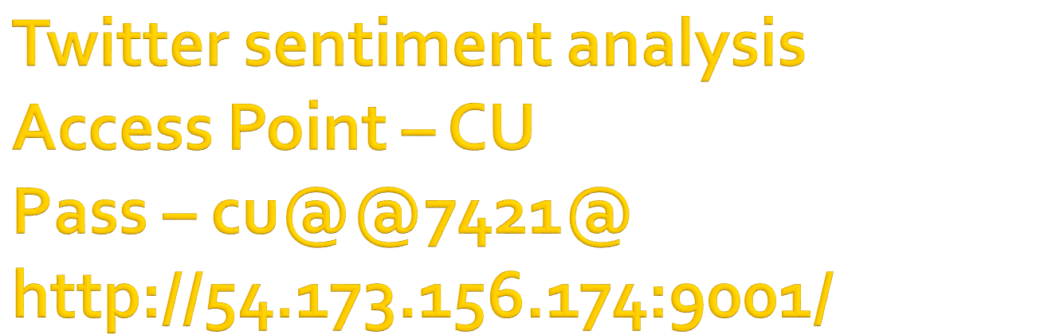
Machine Learning India and Aspiring Minds Research team (research.aspiringminds.com)

Slide 2

A brief on the paper
Quick intro to python for data science
Small intro to ipython notebooks
Hand-on and setting up your arsenal
Twitter api and python-twitter
Intro to sentiment analysis
Python text blob package
Analyze data - Look into it!!
Come back to paper ideas

Slide 3

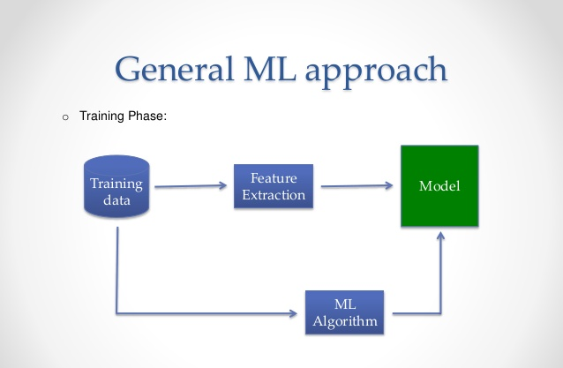
Notes:
What is machine learning?

Slide 4

Three main tasks
  Classification
    Eg – binary classification of tissue (malignant/ benign)
  Regression
    Estimation of house prices
  Clustering
    Users cluster on social media based on political posts

Slide 5
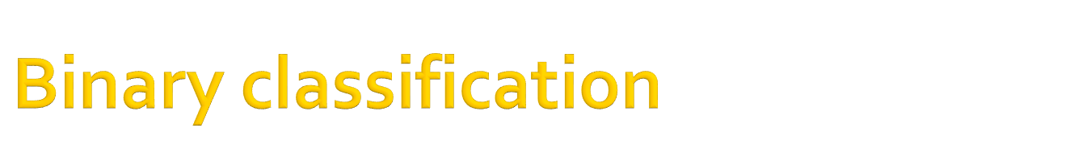
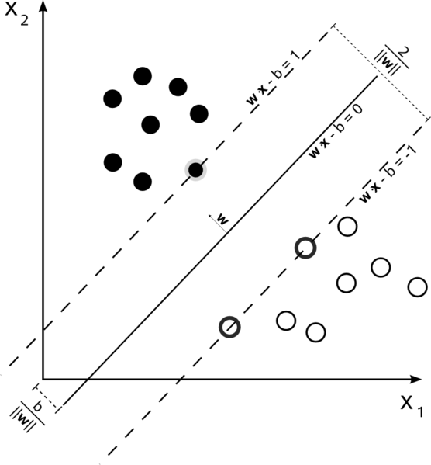
Notes:
Can anyone tell me which is this classifier?

Slide 6

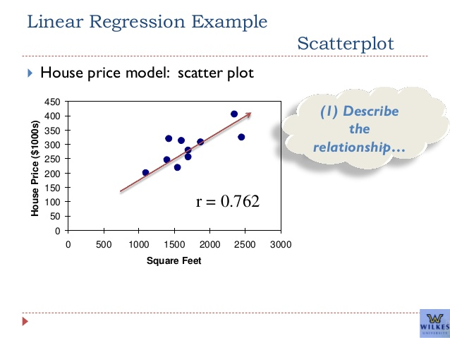

Slide 7

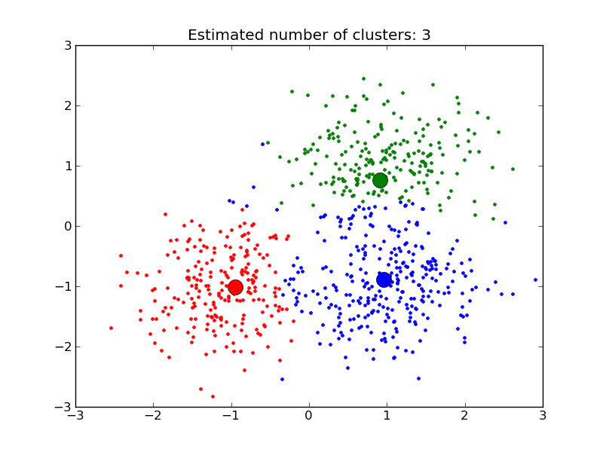

Slide 8

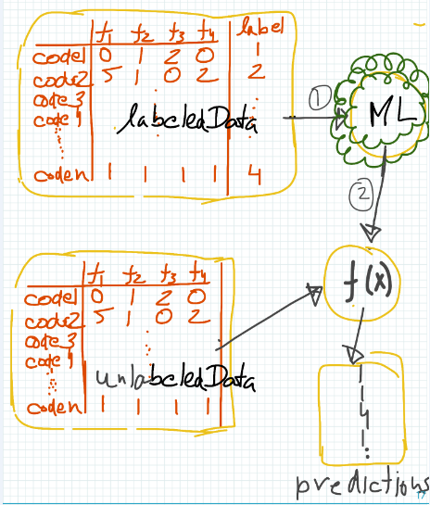
Notes:
How many still does not know what is machine learning?

Slide 9
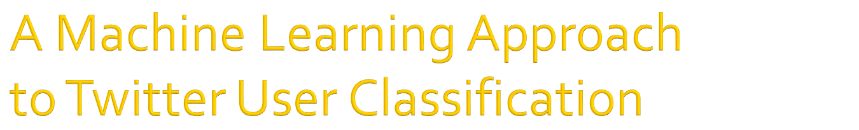
Classify a given twitter user
  Political orientation
  Ethnicity identification
  Affinity for a particular business
Features sets used
  User behavior
  Network structure
  Linguistic content of twitter feeds (imp)

Slide 10

Earlier research used blog, reviews emails to classify
  Gender [Herring and Paolillo 2010]
  User’s location [Jones et al. 2007; Fink et al. 2009]
  Location of origin [Rao et al, 2010]
  Age [Jones et al. 2007; Rao et al. 2010]
  Political affiliation [Thomas, Pang, and Lee 2006; Rao et al. 2010]

Slide 11


Slide 12

General purpose interpreted programming language
Widely used by scientists and programmers of all stripes
Supported by many 3rd-party libraries (currently 21,054 on the main python package website)
Libraries in python are known as packages.
You can install particular library using pip – this is popular default package manager.
  Eg – pip install numpy
Notes:
Extensive library support for data scienists
How many people have used python before and know about pip ?

Slide 13

Some useful packages for data science
Numpy
  Numerical library for python
  Written in C, wrapped by python
Scipy/ sklearn
  Built on top of numpy (i.e. Also fast!)
  Common maths, science, engineering routines
Matplotlib
  Hugely flexible plotting library
Pandas
  Easy to use library for data analysis and modelling
  Dataframes are like sql tables and you can perform operations
  Read, write, data reshaping, slicing, joins, pivots, indexing, etc
Notes:
Has anyone used these packages before?

Slide 14

IPython Notebook is a web-based interactive computational environment
There is a notebook which runs in browser and it connects to a server having a kernel
Containing an ordered list of input/output cells which can contain code, text, mathematics, plots and rich media.
How to start ipython notbook
  $ ipython notebook

Slide 15

Steps
1. Setup your ipython environment and download libraries/ Use our server and setup your ipython notebook
2. Setup API keys for your twitter account
3. Fetch tweets from twitter
4. Run sentiment analysis
5. Analyze results

Slide 16

Clone the repo
  git clone https://github.com/gursimar/iPython-workbooks.git
Start your ipython notebook
  Using ‘ipython notebook’
Upload the ipynb file from the repo
  twitter_sentiment_analysis.ipynb
Install if any packages are required using pip

Slide 17

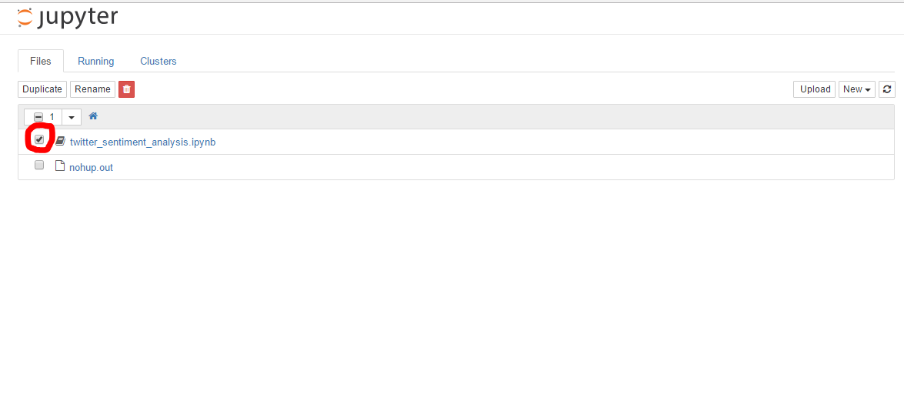


Slide 18

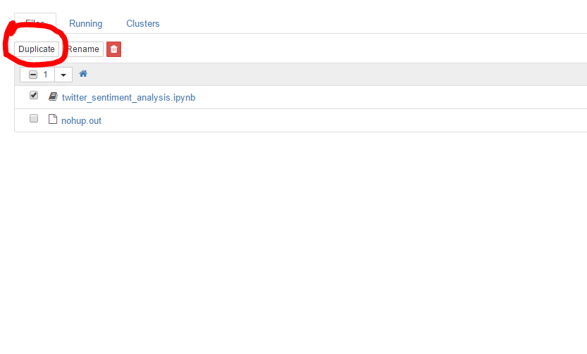

Slide 19

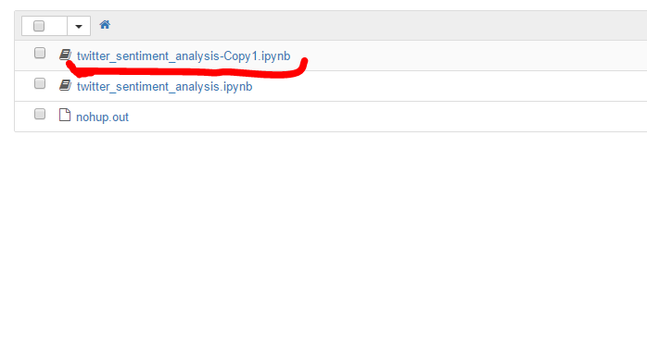

Slide 20

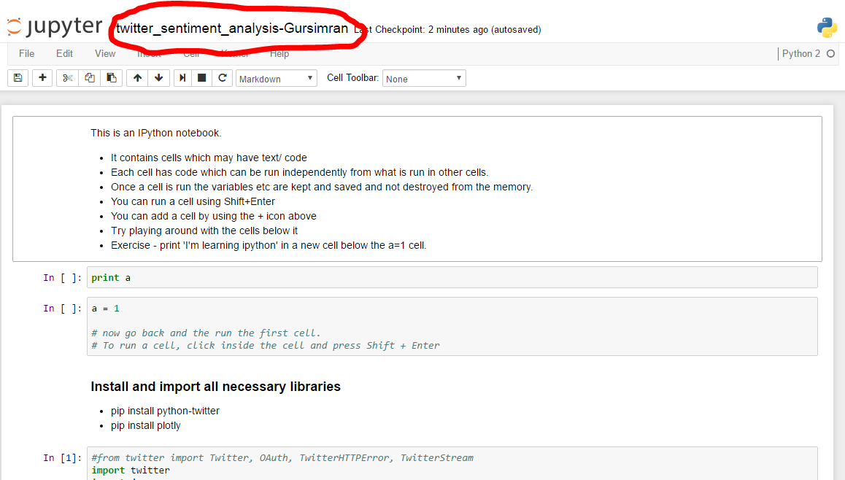

Slide 21

It contains cells which may have text/ code
You can add a cell by using the + icon above
Remove a cell using the scissor icon.
Shift+Enter to execute code inside the cell
Exercise –> add a new cell and print ‘hello’
Exercise 2 -> + cell and

Slide 22

Open https://apps.twitter.com/
Click “Create New App”
Fill out the form, agree to the terms, and click “Create your Twitter application”
Click on “Keys and Access Tokens” tab, and copy your “API key” and “API secret”.
Scroll down and click “Create my access token”, and copy your “Access token” and “Access token secret”.
Access Level -> Read, write, and direct messages (modify app permissions)
- https://apps.twitter.com/app/13519590/keys

Slide 23

oAuth is used to authenticate and authorize
Twitter API Objects
  Tweets
  Users
  Entities – hashtags, media, urls, etc
  Places

Slide 24

It is a python wrapper to the twitter API
Create and object
  api = twitter.Api(credentials)
Interact with twitter API through functions
  Api.FetFriends()
  Api.PostUpdate()
  Api.GetSearch()
  Api.GetTrendsCurrent()
  etc

Slide 25

It’s the voice of the customer
  What are people feeling about a particular topic/ product
Classify the polarity of the article
  Positive, negative, neutral
Various techniques

Slide 26

Cleaning data
  Tokenize and remove stop words
  Remove Stop words
  POS Tagging – select only adjectives/ adverbs
Pass these tokens to a pretrained sentiment classifier

Slide 27
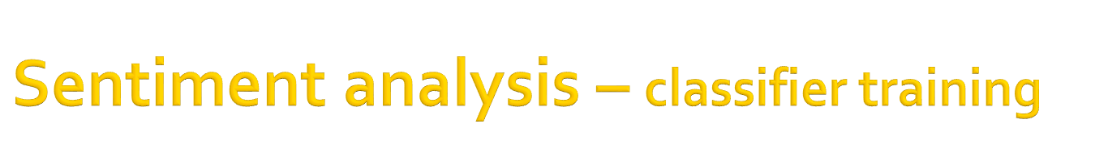
Trained using a supervised data set
  Movie review dataset
  Each review has a label – positive or negative
We process the text as in the previous slide
Then we use a bag of words approach
These features, along with labels are passed to a Naïve bayes classifier.
It gives a score on a scale of [-1, 1]

Slide 28

It is a package to process textual data.
  NLP, POS tagging, Noun phrase extraction, sentiment analysis, classification, translation.
analysis = TextBlob(clean_tweet(tweet))
if analysis.sentiment.polarity > 0:
return 'positive'
elif analysis.sentiment.polarity == 0:
return 'neutral'
else:
return 'negative'

Slide 29

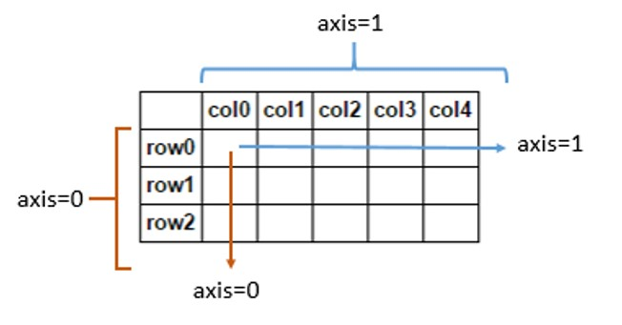
It’s a python package for data manipulation and analysis
  Mainly useful to work on tabular data like in spreadsheets.
A data frame is used for storing data tables

Slide 30
One line commands can be performed
Features – data manipulation
  Loading/ dumping data from/to csv
    pd.from_csv(‘simar.csv’)
  Joins and data merging/ alignment
  Reshaping and pivoting data sets
  Handling missing data
  Advanced indexing and slicing of data

Slide 31

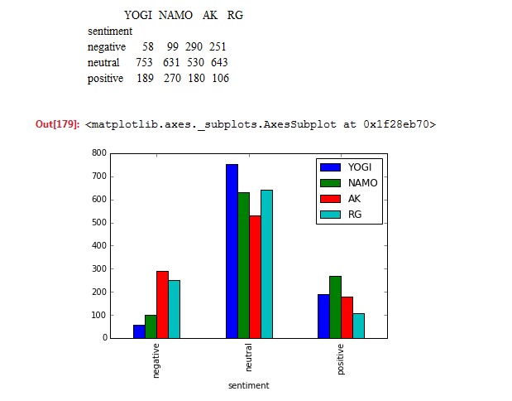

Slide 32

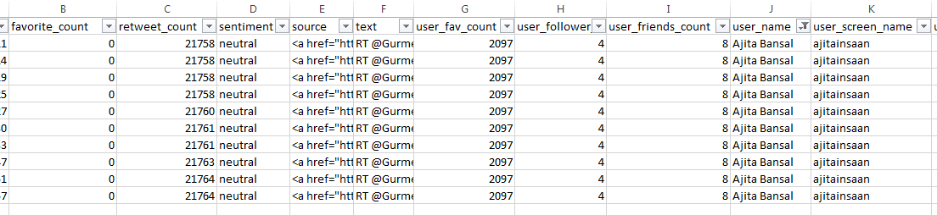
Analyze data in excel
  Same user is doing multiple retweets
  Consider users with fav_count > th | user_follw > th
  Take only one tweet per user; consider retweet count
  See user stats rather than tweet stats
  Implement our own algorithm for sentiment analysis
  Get facebook posts along with twitter

Slide 33


Slide 34


Profile features – weakly correlate with output variables
Regular expressions to extract age, gender, ethnicity
Other features
  Length of user name
  No of numeric and alphanumeric characters
  Use of avatar picture
  No of followers/ friends
  Date of account creation
  Presence of location field

Slide 35

Way a user interacts with twitter
  Average no of messages per day, number of replies
  No of tweets, retweets, their fraction
  Average number of hashtags
  Average time/ std between tweets
Eg - Information seekers
  User who rarely tweets but have many followers
Eg - Information providers
  Users who many times provides urls in their tweets

Slide 36

Encapsulates
  Topics of interest
  Lexical usage
Prototypical words (proto words) – lexical expressions for people having particular interests
    Examples
      younger people use ‘dude’ and ‘lmao’
      democrats tend to use ‘heath care’ more than republicans

Slide 37
Prototypical words (proto words) – lexical expressions for people having particular interests
    Examples
      younger people use ‘dude’ and ‘lmao’
      democrats tend to use ‘heath care’ more than republicans
Prototypical hashtags
Followers and friends
  Eg - Democrats follow democrats

Slide 38

  Meetup every 15 days
Call for speakers and hands-on ideas
Meetup.com -> Join the ML India Chd group
Community driven
Contact
  Gursimran – simar.i3r@gmail.com
  Yuvraj – yuvraj1990singla@gmail.com

Slide 39


Slide 40

Types
  Supervised learning
    You have labelled data
  Unsupervised learning
    There is no labelled data
  Reinforcement learning
    This is fancy new stuff!!!

